Slide 1
Lesson 6:
Programming in Python

Slide 2
Quick Recap
Decision Making
if statement
if..else statement
Nested if statement
Logical Operators(and, or)
Spychat Profile
Placeholders
Import statement
import
from [module_name] import [function_name]
Aliasing modules
4. Functions in Python A. Purpose of function B. Declaration of function C. Definition of function D. Pass by reference vs value
E. Scope of Variables
I. Global Variables
II. Local Variables
5. Loops in Python A. for loop B. while loop C. Nested loops

Slide 3
Well, what modules have we built in our spychat project
Profile of a spy
A menu of choices (today)
Status message for a spy (today)
Add a spy friend
Send and read a secret message
Save chats

Slide 4
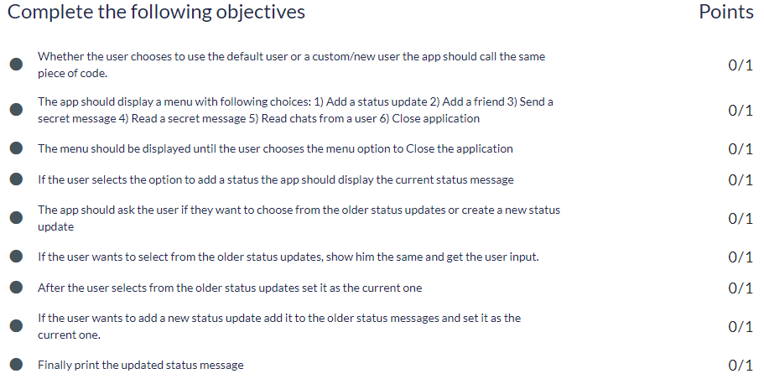
Objective from ACADVIEW website

Slide 5
Adding Menu of Choices
in our SpyChat Application

Slide 6
Print menu for SpyChat multiple times?
To print a menu multiple times, we can enclose it in a while loop using a variable denoting the Exit status (to be taken from the user) as the condition.
def start_chat(spy_name, spy_salutation, spy_age, spy_rating):
show_menu = True
while (show_menu):
menu_choice = input("1. Add a status update \n2. Close Application")
if menu_choice == 1:
print('You chose to update the status')
elif menu_choice == 2:
show_menu = False

Slide 7
Now that we have defined the start_chat function let us call it:
import sys
import default
menu_choice= input("Do you want to continue with default settings(y/n)")
if menu_choice.upper() == 'Y':
spy_name = default.spy_name
spy_salutation = default.spy_salutation
spy_age = default.spy_age
spy_rating = default.spy_rating
elif menu_choice.upper() == 'N':
spy_name = input("Enter your Name: ")
spy_salutation = input("Enter your Salutation (Mr. or Mrs.): ")
spy_age = input("Enter your age: ")
spy_rating = input("Enter your rating: ")
start_chat(spy_name, spy_age, spy_rating)

Slide 8
Let’s Add Features in our SpyChat Application

Slide 9
Let us add a feature to update the status.
We create a variable in the beginning of the show_menu function to store the current status. In the start, it is set to None to indicate no value.
def start_chat(spy_name, spy_salutation, spy_age, spy_rating):
current_status_message = None show_menu = True
while (show_menu):
menu_choice = input("1. Add a status update \n2. Close Application")
if menu_choice == 1:
print('You chose to update the status')
elif menu_choice == 2:
show_menu = False

Slide 10
Create a function to add the status message.
This function takes the current status as an input. It should return the updated status.
We output the current status in the add_status function if it exists and print an appropriate message otherwise.
def add_status(current_status_message):
if (current_status_message != None):
print("Your current status message is " +current_status_message+ "\n")
else:
print("You don't have any status message currently")
update_choice = input("Do you want to select from the older status (y/n)?")

Slide 11
Create a function to add the status message.(Contd.)
One of the feature requirements is for the user to have an option to choose from the older status updates (like WhatsApp). This requires the need to store every status somewhere so that it can be retrieved later. We will use a list to do this work.
STATUS_MESSAGES = []
def add_status(current_status_message):
if (current_status_message != None):
print("Your current status message is " +current_status_message+ "\n")
else:
print("You don't have any status message currently")
update_choice = input("Do you want to select from the older status (y/n)?")
if update_choice.upper() == "N":
new_status_message = input("What status message do you want to set?")
if len(new_status_message) > 0:
updated_status_message = new_status_message
STATUS_MESSAGES.append(updated_status_message)

Slide 12
Create a function to add the status message.(Contd.)
When the spy wants to set an old status as the current status, we need to print all the previously set statuses. So, we need to print each value stored in the list.
To print all the previous statuses, we will use a loop(for or while).
item_position is a variable initialized to give a number next to every status.
STATUS_MESSAGES = []
def add_status(current_status_message):
…
…
update_choice = input("Do you want to select from the older status (y/n)?")
…
…
elif update_choice.upper() == 'Y':
item_position = 1
for message in STATUS_MESSAGES:
print item_position + ". " + message
item_position = item_position + 1

Slide 13
Create a function to add the status message.(Contd.)
Next, we want the user to select the desired status by giving us a number corresponding to the status in the output of the for loop (item_position Variable).
We will use this number as an index to retrieve the status from the list.
STATUS_MESSAGES = []
def add_status(current_status_message):
…
…
update_choice = input("Do you want to select from the older status (y/n)?")
…
…
elif update_choice.upper() == 'Y':
item_position = 1
for message in STATUS_MESSAGES:
print item_position + ". " + message
item_position = item_position + 1
message_selection = input("\n Choose from the above messages ")

Slide 14
Create a function to add the status message.(Contd.)
We have to check if the number entered by the user is valid, i.e. it is less than or equal to the length of the STATUS_MESSAGES list.
STATUS_MESSAGES = []
def add_status(current_status_message):
…
…
update_choice = input("Do you want to select from the older status (y/n)?")
…
…
elif update_choice.upper() == 'Y':
item_position = 1
for message in STATUS_MESSAGES:
print item_position + ". " + message
item_position = item_position + 1
message_selection = input("\n Choose from the above messages ")
if len(STATUS_MESSAGES) >= message_selection:
updated_status_message = STATUS_MESSAGES[message_selection - 1]

Slide 15
Create a function to add the status message.(Contd.)
Finally, we return the updated status message at the end of add_status function.
STATUS_MESSAGES = []
def add_status(current_status_message):
…
…
update_choice = input("Do you want to select from the older status (y/n)?")
…
…
elif update_choice.upper() == 'Y':
item_position = 1
for message in STATUS_MESSAGES:
print item_position + ". " + message
item_position = item_position + 1
message_selection = input("\n Choose from the above messages ")
if len(STATUS_MESSAGES) >= message_selection:
updated_status_message = STATUS_MESSAGES[message_selection - 1]
return updated_status_message

Slide 16
Create a function to add the status message.(Contd.)
In the start chat function, we update the value of current_status_message variable using the value returned by add_status function.
def start_chat(spy_name, spy_age, spy_rating):
def start_chat(spy_name, spy_salutation, spy_age, spy_rating):
current_status_message = None
show_menu = True
while (show_menu):
menu_choice = input("1. Add a status update \n2. Close Application")
if menu_choice == 1:
print('You chose to update the status')
current_status_message = add_status(current_status_message)
elif menu_choice == 2:
show_menu = False

